Slide 1
Electrical Safety

Slide 2


SAFETY CAN BE DEFINED AS FREEDOM FROM DANGER/ FREEDOM FROM INJURY
THE TASK COMPLETED WITHOUT ANY ACCIDENT
(Safety' is absence of danger of physical harm or freedom from unacceptable risk of harm.)

Slide 3


HEALTH IS FREEDOM FROM ILLNESS/DISEASES
(Health is a state of complete physical, mental and social well - being and not merely the absence of disease or infirmity)

Slide 4
Accident
An Unexpected or unplanned event that resulting injury to person or damage to property.
Injury accident - where the unplanned, unwanted event leads to some sort of personal injury,
e.g. a cut hand
Damage only accident - where the unplanned, unwanted event leads to equipment or property damage but not personal injury,
e.g. a wall is demolished

Slide 5
Near Miss
An unplanned event that did not resulting injury to person or damage to property but it has potential to do so.
Dangerous Occurrence
A ‘near miss’ which could have led to serious injury or loss of life. Dangerous occurrences need to be reported to regulations authority defined by the law
Ill-health
A disease or medical condition that is directly attributable to work,
e.g. dermatitis as a result of exposure to chemicals.
INJURY
A physical condition that is directly attributable to work, Example : Burn, Cut and Fracture

Slide 6
Risk A combination of the likelihood of an occurrence of a hazardous event and the severity of injury or damage to the health of people caused by this event.
Risk Assessment
The process of evaluating the risks to safety & health arising
from hazards at work.

Slide 7







???
GLOBAL SAFETY STUDIES
GLOBAL SAFETY STUDIES

Slide 8





???
MORAL
LEGAL
FINANCIAL

Slide 9


Moral I Humanitarian Reasons:
Our lives depend on what we do at work, we all have a moral obligation not to cause harm to others, and employers have a moral obligation towards their employees and others to prevent Injuries and ill-health which result in great deal of pain and suffering.

Slide 10


Legal Reasons:
To avoid prosecution, the criminal and civil law
demands active management of risks, not
just compliance with prescribed standards. It is a specific legal requirement to safeguard the health and safety of workers and others. Risk management is the cornerstone of modern health and safety law.

Slide 11


WHEN THE ACCIDENT OCCURE THEIR WILL BE DIRECT
AND INDIRECT COST ASSIGHNED WITH THAT EVENT..
DIRECT COST
INDIRECT COST

Slide 12

Financial Reasons:
Accidents at work cost a great deal of money, Interrupt production & business disruption, Medical treatment & compensation. When an accident occurs there are two types of losses that the organization may face Direct Costs &Indirect Costs. Some of these losses can be insured against many of them will be uninsured.

Slide 13
Accidents and ill-health cost money Costs may be:
Direct - measurable costs arising directly from accidents
Indirect - arise as a consequence of the event but may not directly involve money. Often difficult to quantify

Slide 14
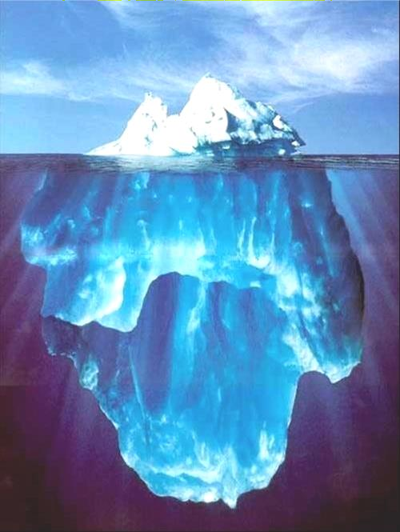
The Cost of Accidents at Work
£1
£8 - £36

Slide 15
Direct & Indirect costs of an Accident.
Direct Costs of Accident: Fines & Penalties Medical costs
Sick pay
Compensation
High insurance premium
Indirect Costs of Accident:
Delays to production following the accident
Lost time for investigation
Lost morale and damaged worker relationships
Cost of recruitment of replacements
Lost reputation
Damage to the environment (e.g. from chemical incidents)

Slide 16
BENEFITS OF GOOD HEALTH & SAFETY MANAGEMENT
Increased levels of compliance
Improved production
Improved staff morale
Improved company reputation
Reduced accidents
Reduced ill health
Reduced damage to equipment
Reduced staff complaints
Reduced staff turnover
Reduced insurance premiums
Reduced fines and compensation claims

Slide 17












Slide 18
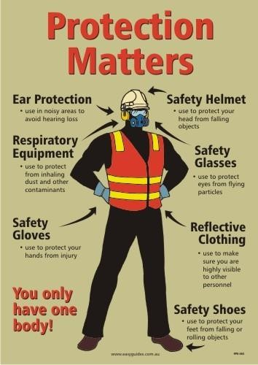





Slide 19


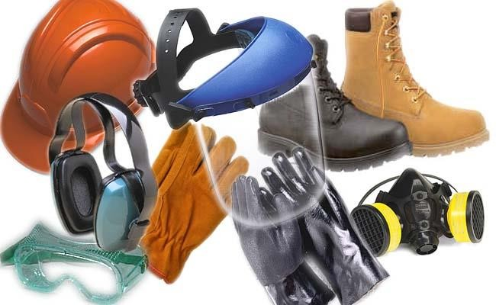
PERSONAL PROTECTIVE EQUIPMENT A VARIETY OF DEVICE,TO PROTECT EMPLOYEES FROM INJURY.

Slide 20
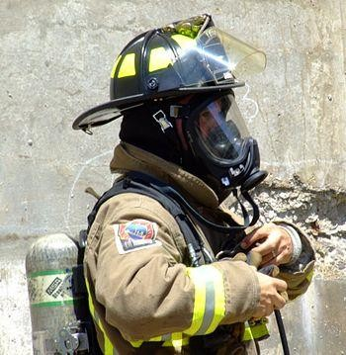
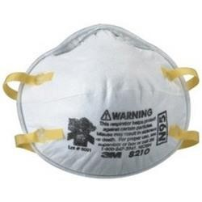
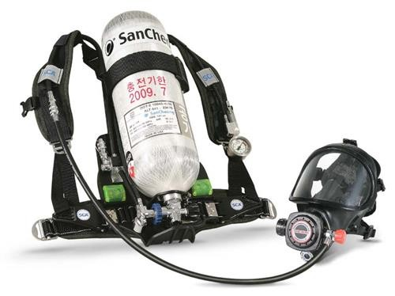
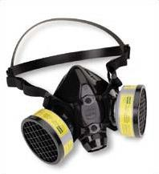
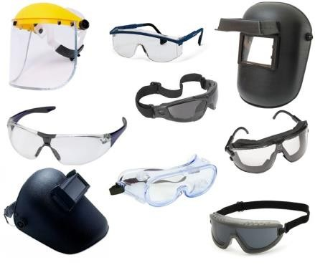

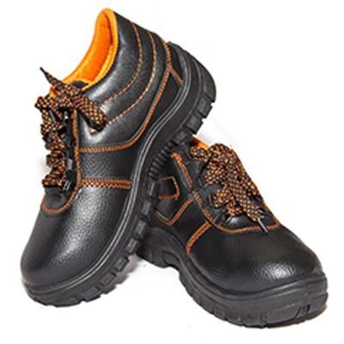
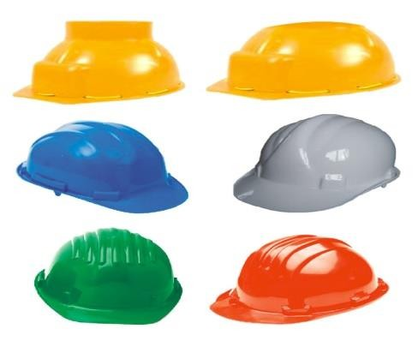
RESPIRATORY PROTECTIVE EQUIPMENTS
Eg; SCBA, AIR RESPIRATORS ETC..
NON- RESPIRATORY PROTECTIVE EQUIPMENTS
Eg; HARD HAT, GLOVES, GOGGLES, SAFETY SHOES
ETC..

Slide 21

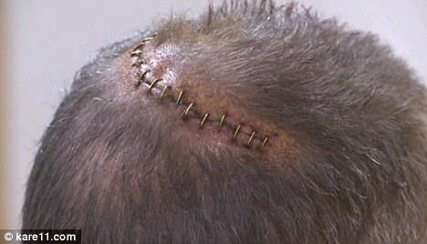
HEAD INJURIES

Slide 22



SAFETY GLASSES
SAFETY GOGGLES
FACE SHIELDS
WELDING GOGGLES
LASER SAFETY GLASS

Slide 23
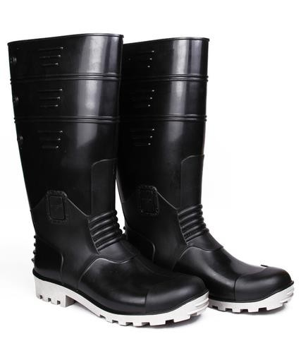
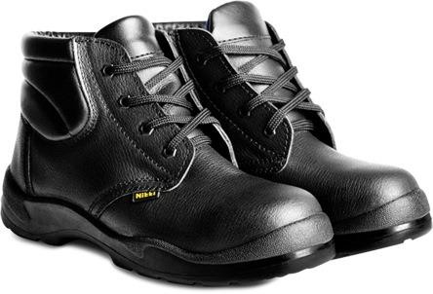
FOR PROTECTION FEET AND LEGS FROM FALLING OBJECTS, SHARP OBJECTS, HOT SURFACE AND WET SURFACE.
SAFETY SHOES SHOULD BE STURDY AND HAVE RESISTANT TOE
SOME SHOE METAL INSOLE PROTECTIVE AGAINST
PUNCTURE WOUNDS

Slide 24

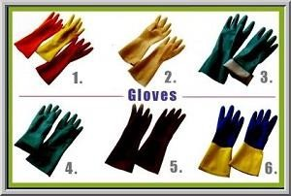
HAND PROTECTION MUST BE PROVIDED TO PROTECT FROM BURNS, ABRASION, CUTS, PUNCTURES, BRUISE, CHEMICAL EXPOSURE..

Slide 25
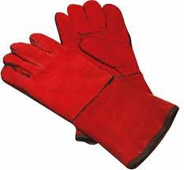

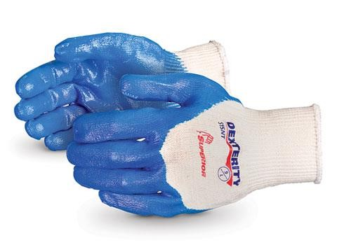

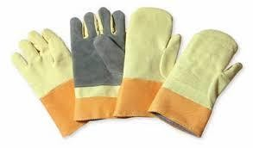
LEATHER GLOVES
COTTON GLOVES
CHEMICAL PROTECTION GLOVES
INSULATED RUBBER GLOVES
WELDING GLOVES

Slide 26
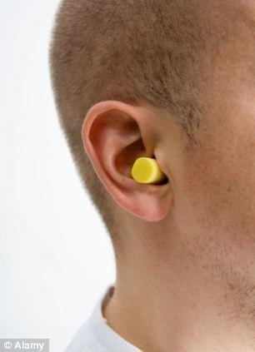
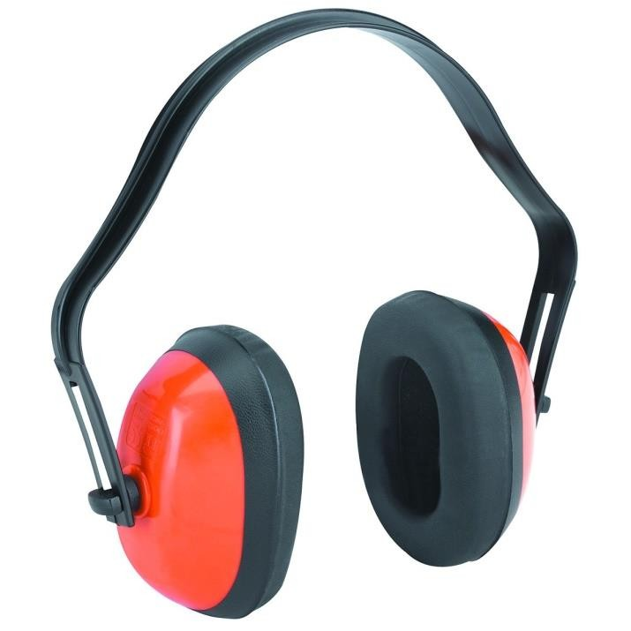
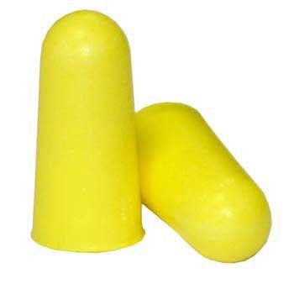
EAR PROTECTION SHOULD BE PROVIDED AND MUST BE WORN BY ALL EMPLOYEES EXPOSED TO AN 8 HOUR OF 85 DB OR GREATER
EAR MUFF
EAR PLUG

Slide 27
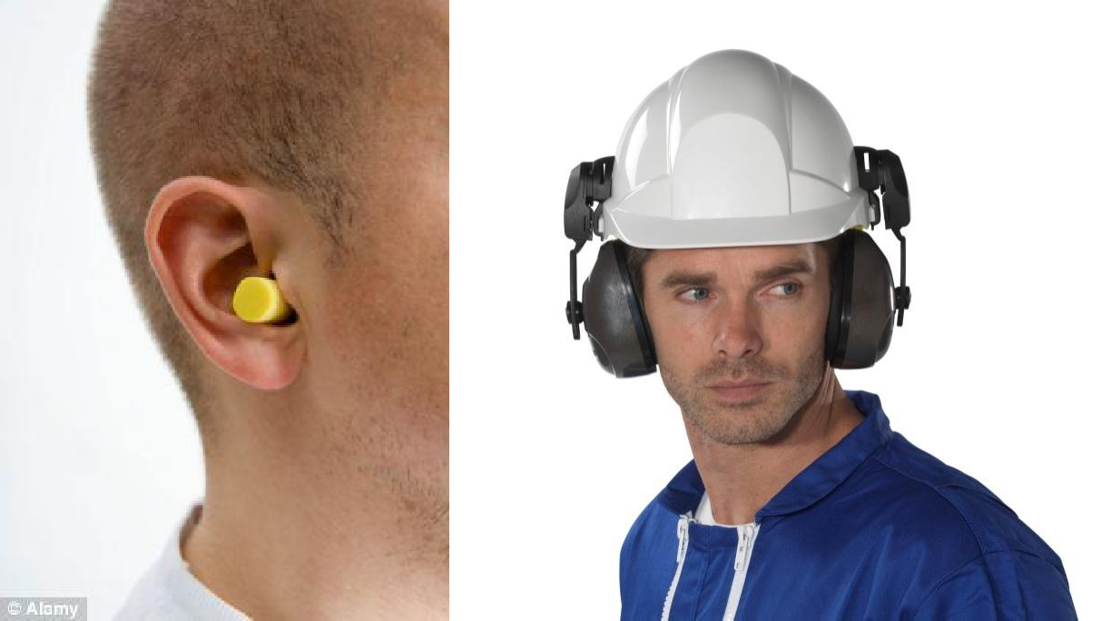
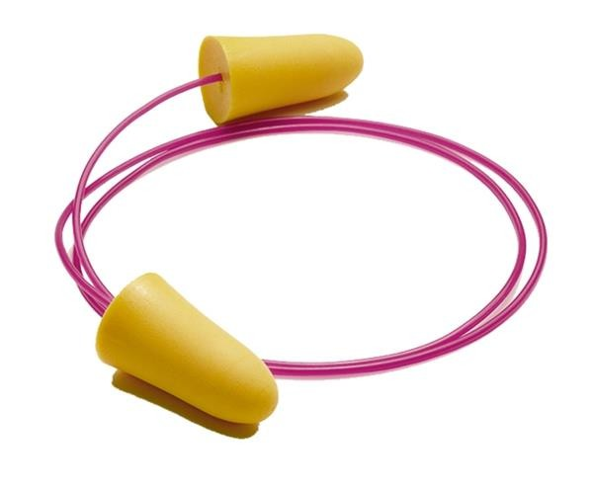
EAR PLUGS
EAR MUFFS

Slide 28


Slide 29
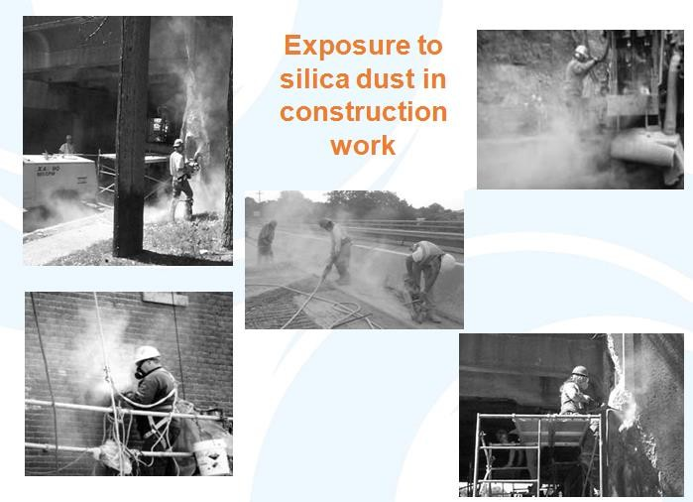

Slide 30
Principles, Hazards and Risks Associated with The Use of Electricity in The Workplace

Slide 31
Electrical Terms…
Conductors:
A material that allows electricity to flow easily:- e.g. cooper, steel, water
Insulators:
Materials that have a high resistance to electrical current: e.g. plastic, rubber, wood.

Slide 32
Ohm’s Law
I = V/R
Current
= Voltage/Resistance
V
I
R
Notes:
Current is given the symbol “I” rather than “C” as “C” is already used for capacitance!
The pyramid may help delegates remember Ohms law. If you cover the parameter that you are interested in, the remaining ones show you how to calculate it. Parameters side by side are multiplied, parameters over each other mean divide.
So to calculate Volts, cover the V then V = IxR
To calculate current, cover over the I then I=V/R
It is unlikely that students will have to do Ohms law calculations in an exam BUT it is really useful to use to explain why reduced low voltage equipment etc. is a good thing!

Slide 33
Electrical Terms
Volts (Pressure difference):
The unit of measurement of electrical pressure.
Amps (Current):
The unit of measurement of flow
Ohms (Resistance):
The unit of measurement of resistance

Slide 34
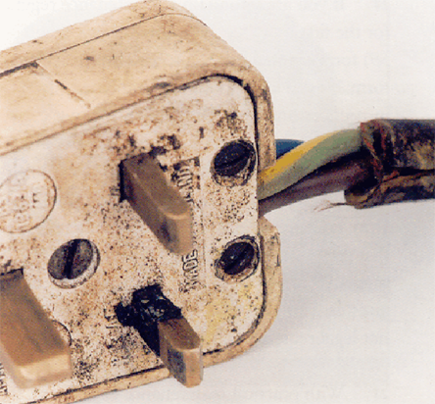
The Hazards of Electricity
PRIMARY HAZARDS
Electric shock
Electric fire & explosion
Electric flash
Electric burns

Slide 35
The Hazards of Electricity
Secondary Hazards
Person falling from height
Dropping of tools & objects
Health hazards due to release of toxic gas & production of UV rays
Psychological effects
Emotionally anxious
Distracted
More prone to accidents

Slide 36
Health Effects
Damage to the nervous system
Irregular heartbeat (fibrillation)
Internal burns
Muscular contractions
Physical trauma
Stopping breathing (respiratory paralysis)
Stopping the heart (cardiac arrest)
Surface burns to the skin
Notes:
Use this to illustrate the effects of electric shock on the body. Burns are covered later.

Slide 37
Severity of Shock Influenced By:
Voltage – the higher the voltage, the greater the current
Duration – the length of time that a person is exposed
Resistance – skin condition, clothing, etc.
Current path – the route that the electricity takes through the body
Contact surface area – the more skin that is in contact, the more severe the injury
Environmental factors – metal surfaces, humidity, etc.
Notes:
Also mention that secondary hazards exist which may result in other injuries, such as work at height (person may fall if receiving a shock)

Slide 38
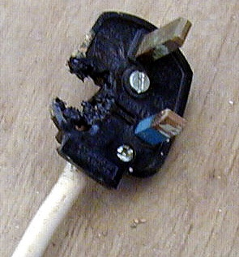
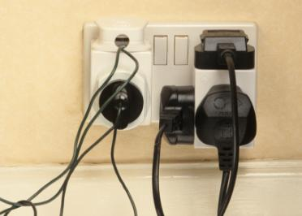
Fire and Explosion
Causes
Selection of improper/substandard equipment and materials.
Electrical installation not in accordance with statutory regulations.
Overloading of equipment.
Maintenance negligence.
Failure of insulation level.
Poor internal connections
Flammable atmosphere present
Lightning.
Water seepage.
Static electricity.

Slide 39
Arcing
Ability of electricity to “jump” across an air gap
Usually involves high voltage
Main hazards
Electric shock
Burns (direct, indirect)
Damage to eyes from UV radiation emitted
Notes:
Video available as a discussion at http://www.youtube.com/watch?v=9tzga6qAaBA. Lots you can get out of this – the term “live” and “hot” mean the same. Shows electrical arcing. Stress that wearing the protective suit isn’t the answer in normal circumstances!!

Slide 40
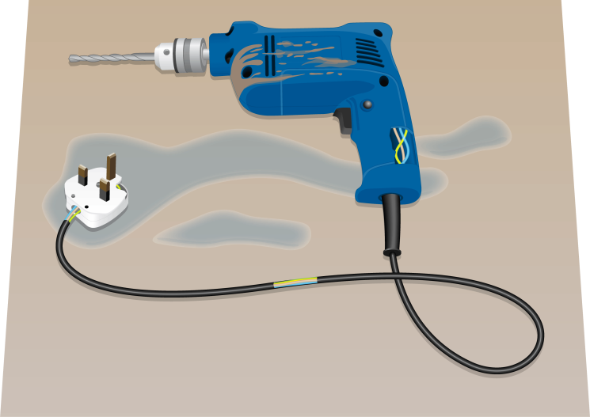
Group Discussion Point
What type of incidents could occur when using portable electrical equipment?

Slide 41
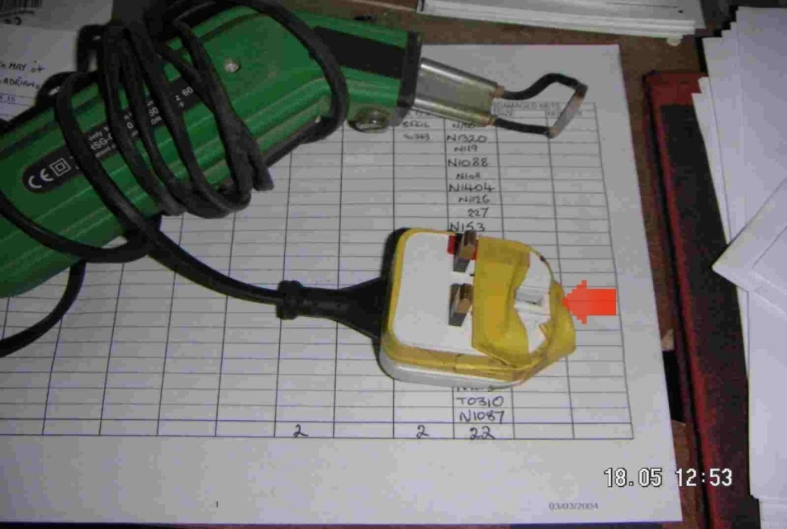
Portable Electrical Equipment
Accidents with Portable Electrical Equipment can be due to:
Using unsuitable equipment
Using in damaged conditions
Misuse
Physical abuse such as driving over cables
Repairs carried out improperly
Continued use of faulty, defective equipment
Chemical/abrasion damage to the cables
Lack of inspection testing or maintenance
Notes:
Image from a friend, source unknown

Slide 42
PRECAUTIONS USING Portable Electrical Equipment
Reduced voltage operation
Use of residual current devices
Protected against overload
Cables insulated
Casing without damage
Sufficient socket outlets
Use of cable drums
Correct maintenance and repair
Regular inspections and checks
Properly trained staff
Notes:
Image from a friend, source unknown

Slide 43
End of Section Quiz
Explain what is meant by the terms:
Voltage?
Current?
Resistance?
What are the hazards associated with electricity?
How can electrical equipment cause fires?
Notes:
1 • Voltage – a measure of the potential difference or electrical driving force/pressure that is forcing electricity through the conductor (unit: volt; symbol: V).
• Current – a measure of the rate of flow of electricity through a conductor (unit: ampere or amp; symbol: I).
• Resistance – a measure of how much a component in the circuit resists the passage of electricity (unit: ohm; symbol: R).
2- Electric shock, fire and explosion, burns, arcing, secondary effects
3- faulty equipment overheating; overloading; misuse; ignition of a flammable atmosphere; heat or sparks generated during normal operation

Slide 44
Control Measures

Slide 45

Electrical Safety
Display electrical equipment & cable routing layout
All electrical installation to be tested & commissioned as per standard.
All DB’s should be covered
Earthing of all electrical installations
Regular maintenance

Slide 46
ELECTRICAL SAFETY
Records to be maintained, RCD
Display caution boards
Provide RCD for portable equipment
LOCKOUT TAGOUT
Follow rules and regulations
Follow safety measures
Adopt protective system
Insulation
Regular inspection

Slide 47
Display electrical equipment & cable routing layout
All electrical installation to be tested & commissioned as per standard.
All DB’s should be covered
Earthing of all electrical installations
Regular maintenance
Records to be maintained, RCD
Display caution boards
Provide RCD for portable equipment
LOCKOUT TAGOUT
Follow rules and regulations
Follow safety measures
Adopt protective system
Insulation
Regular inspection

Slide 48
Protective Systems
Fuses
Earthing
LOTO
Reduced and low voltage systems
Residual Current Devices (RCD’s)
Double insulation

Slide 49
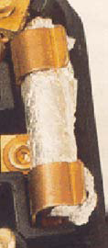
Fuses
Designed to protect the equipment not the people!
Form a weak link in a circuit
Designed to overheat and melt if the current exceeds the fuse rating
Fuses are proven safety devices for overload conditions
Check the fuses for their current ratings
Notes:
Advantages of fuses:
• Very cheap and reliable.
• Offer a good level of protection for the electrical equipment against current overload that might damage the equipment or cause overheating, fire or explosion.
Limitations of fuses:
• They primarily protect equipment and not people. It is possible to receive a severe, even fatal, electrical shock from equipment that is protected by a fuse for two reasons:
– A fuse does not stop current flow quickly enough to prevent ventricular fibrillation.
– The current flow must be above the fuse rating for the fuse to operate and this may be above the 60 mA capable of causing fatal injury.
• Very easy to bypass, e.g. by wrapping the fuse in tinfoil.

Slide 50
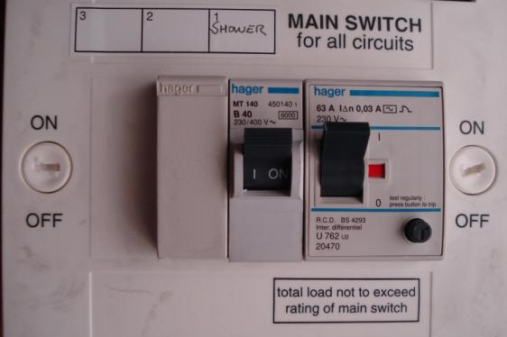
Circuit Breaker
Protects equipment not people
Electromagnetic device designed to break the circuit when overloaded
Circuit breakers protect circuits from overload (fire)
Notes:
Circuit breakers are resettable fuses
advantages of MCBs - they do not have to be removed in order to be reset and so they are more tamper-proof than fuses. The limitations of MCBs are similar to those for fuses.

Slide 51
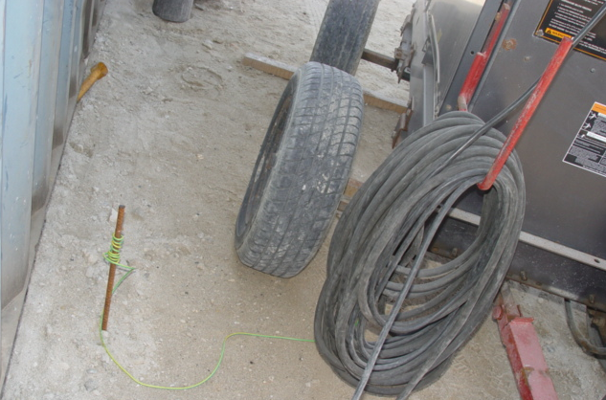
Earthing
Outer metal casing connected to earth by wire
Provides fault current with a low resistance path to earth
Electric shock should be minor
Notes:
Earthing is a way of protecting equipment so that in the event of an electrical fault, current flows safely to earth rather than flowing through a person who might be touching the equipment. The earth wire of an item of electrical equipment is usually connected to the outer metal casing or chassis of the equipment. If a fault develops and the casing or chassis becomes live then a current will flow down this earth wire. Electricity always takes the path of least resistance, and since the earth wire will have very low resistance the majority of fault current will flow safely to earth through the wire. Any person touching the casing will receive a minor shock.
Advantages of earthing:
• It protects the person from fatal electric shock.
• It often provides secondary protection to the equipment because a large fault current flowing to earth will overrate the fuse or MCB.
Limitations of earthing:
• A poor or broken earth connection will prevent the earth from working properly, but since the earth wire does not take part in the normal functioning of the equipment this fault can go completely undetected.
• It is easy to disconnect and disable.

Slide 52
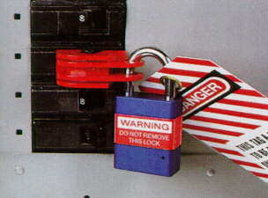
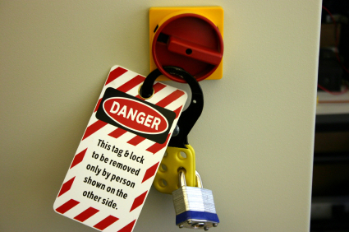
Lockout/Tag out
The purpose of lockout/tag out is to prevent unexpected energization or start up of equipment could cause injury
The placement of a lock and tag on an isolating device which ensures that the equipment being controlled cannot be re-energized until the locking device is removed.
The ultimate goal of lockout/tag out is to protect the safety and health of employees.
Notes:
The advantage of isolation as a form of protection is that it is a very effective method of ensuring that people cannot be injured by electrical energy when working on an electrical system.
The limitation of isolation is that, by definition, the electrical system is dead. Certain types of testing, fault finding and electrical installation and repair work have to be carried out with the electrical system on and live. In these circumstances isolation cannot be used.

Slide 53







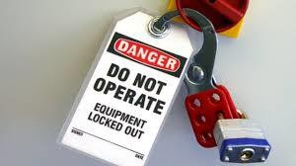
GLOBAL SAFETY STUDIES
GLOBAL SAFETY STUDIES

Slide 54


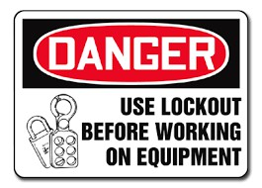
DEFINITION
LOCKOUT MEANS TO PHYSICALLY NETURALIZE ALL ENERGIES IN A PIECE OF EQUIPMENT BEFORE BEGINNING ANY MAINTENANCE OR REPAIR WORK. LOCK OUT GENERALLY INVOLVE , STOPPING ALL ENERGY FLOWS AND PROVIDE A TAG TO HELP CONTROL MECHANICAL AND ELECTRICAL ISOLATION PROCEDURES.

Slide 55



ELECTRICAL DEPT; MECHANICAL DEPT; INSTRUMENTATION DEPT
RED
YELLOW
BLUE

Slide 56


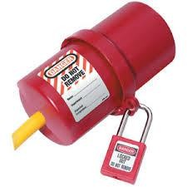
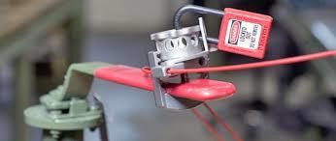
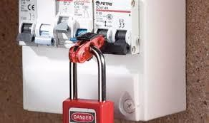
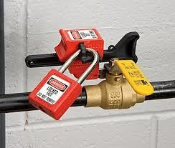
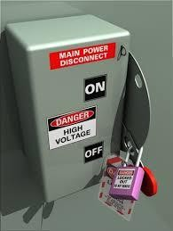
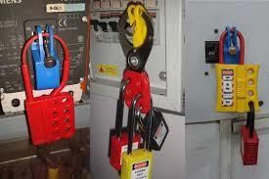
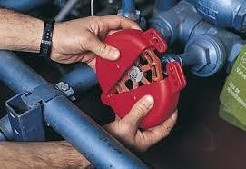
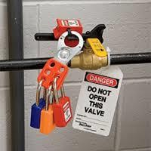
DIFFERENT TYPES OF LOCKS

Slide 57



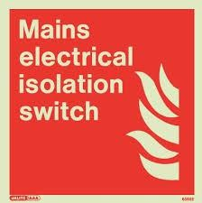
CUT OFF THE SPACE FROM ELECTRICAL SOURCES,
ROTATING PARTS, HAZARDOUS MATERIALS Etc….

Slide 58
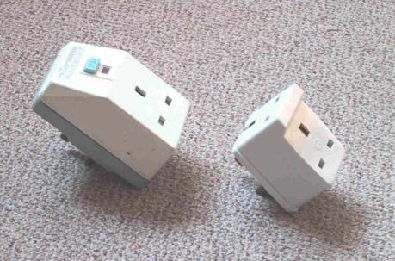
Residual Current Devices
Designed to protect people!
Interrupt supply in event of a small leak of current to earth
Very sensitive: 30 mA
Very fast: 30 ms
Compare current in live and neutral
Should be regularly tested
Notes:
The advantage of RCDs is that they provide excellent protection for people in the event of electric shock.
The limitations of RCDs are that they:
• Do not provide over-current protection (they are not a fuse and work on a completely different principle).
• Have to be tested periodically and this is often not done.
• Can cause repeated circuit tripping if there is a fault and this can encourage people to not use them or to disable them.

Slide 59
Residual Current Devices
Advantages | Disadvantages
Rapid and sensitive Excellent protection for people in the event of electric shock Difficult to defeat Easy to use, test and reset | May isolate crucial equipment if one RCD covers a number of distribution points, e.g. freezers and computers Mechanical device, which could fail Only protects against earth leakage faults (no overload protection)
Notes:
The advantage of RCDs is that they provide excellent protection for people in the event of electric shock.
The limitations of RCDs are that they:
• Do not provide over-current protection (they are not a fuse and work on a completely different principle).
• Have to be tested periodically and this is often not done.
• Can cause repeated circuit tripping if there is a fault and this can encourage people to not use them or to disable them.

Slide 60
Competent Persons – Refresher!
What do we mean by the term “competence”?
?

Slide 61
Competent Persons
Knowledge
Of electricity and electrical work
Ability
Understanding of the system, hazards and precautions
Understanding of when it is safe/unsafe
Training
Experience
Experience of electrical work
Notes:
Remember KATE from IGC 1.
The extent of personal knowledge and experience needed will have to be decided by the employer. It may be that these requirements can be relaxed provided an adequate level of supervision is being applied (for example, an apprentice electrician can gain experience provided they are appropriately supervised).

Slide 62
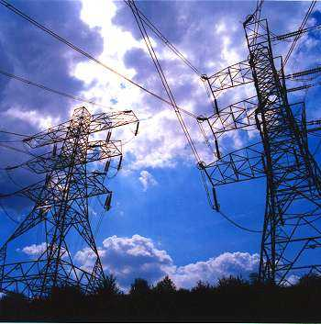
Electricity
Hazards specific to construction:
Contact with overhead power lines
Contact with buried services

Slide 63
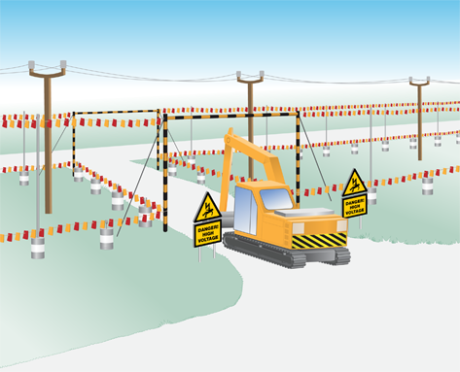
Overhead Power Line – Precautions
Isolating the power supply
Using SSW and permit systems
Sleeve low voltage power lines
Using barriers, signage and goal-posts
Using banksmen
Using non-conducting equipment

Slide 64
Buried Cables
May be struck during excavations
Can result in: Arcing, shock, burns, fire
Precautions
Check plans
Isolating the power supply
Using SSW and permit systems
Competent person
Insulating PPE Boots, Gloves and etc
Insulated tools
Detection equipment
Expose by hand digging
Identify and label
Notes:
Video “a bright arc, a guide to powerline safety” at http://www.youtube.com/watch?v=0tIa564zW74. WARNING Some graphic injuries of burns. Useful as it recaps effects of electricity on the body. Reference to lots of local requirements but the basic information is sound.
Buried cables were covered in element 1 of this unit (excavations)

Slide 65
Precautions for Working Live
Trained and Competent Staff
Accompanied by another person
Adequate Information about the risks
Suitable insulated tools
Insulated barriers or screens
Suitable instruments and test probes
Personal protective equipment / rubber mats
Permit to work
Restricted access
Notes:
Worth mentioning that exposed conductors may exist within the workplace - commonly found as the power source for overhead gantry cranes. Care to be taken when people are working near these conductors i.e. isolate before inspector carried out crane examination. I once found a crane running overhead within touching distance on a warehouse gantry – it was safe by location years before when it was installed, but the company installed an office on a mezzanine level and didn’t appreciate the hazard.
Since most overhead power lines are un-insulated, danger is created if the power line is touched or if
any conducting material is positioned close enough for electricity to arc across. This might be the case
during routine work in any workplace, but is a particular issue associated with construction work.
Prevention of accidents associated with proximity to live overhead power cables can be achieved by:
–– Isolating the power supply when working in the vicinity of power lines. If power cannot be isolated, it may be possible to sleeve low voltage power lines.
–– Using SSW and permit systems to control access into danger areas.
–– Using barriers, signage and goal-posts to keep plant and vehicles a safe distance from power lines.
–– Using banksmen when plant is manoeuvring near power lines.
–– Using non-conducting equipment, such as fibreglass ladders.

Slide 66
Group Syndicate Activity
What action should be taken on finding a person suspected to have suffered an electric shock?

Slide 67
Emergency Action
Don’t touch the casualty
Isolate the supply
Summon help
Give cardio / pulmonary resuscitation
Airways
Breathing
Circulation
Treat burns
Remain with the casualty until the emergency services arrive
Notes:
Discuss the different methods of isolating the person from the power, by turning off the power or moving the person away from the conductor with a non-conducting pole etc.

Slide 68
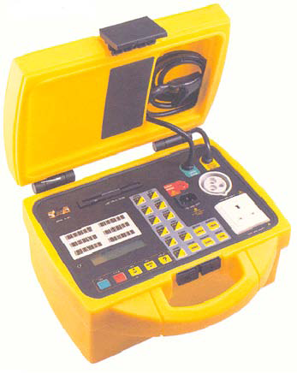
Inspection and Maintenance
User checks
Formal visual inspection
Combined inspection and testing

Slide 69
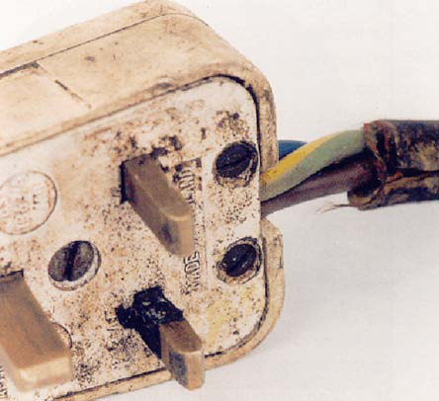
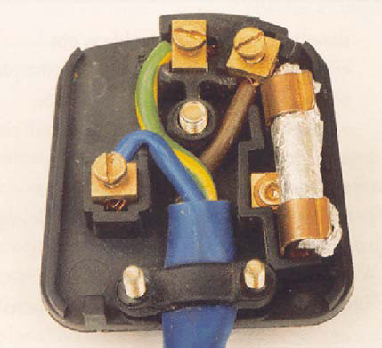
User Checks
Damage to cable sheath
Damage to plug
Flex fully insulated
Inadequate joints
Unsecured casing
Wet or contaminated
Damage to casing of equipment
Burns/scorch marks
Notes:
Some items of electrical equipment should be visually inspected by the user routinely before use. This is particularly important for portable electrical equipment that is used in environments where damage can easily occur (such as a power tool used on a construction site).
This user check does not involve any form of dismantling, but just careful visual inspection of the equipment. If visual inspection or tests show that the equipment is unsafe, then it must be taken out of service and repaired or discarded.
Initially the equipment should be checked for suitability to ensure that it is appropriate for the task in hand, and that the equipment conforms to the relevant standards e.g. CE marked if for use in Europe.

Slide 70

Formal Visual Inspection
User checks plus:
Remove plug cover and check fuse
Check cord grip
Check terminals are secure and no signs of internal damage
Done by competent person

Slide 71

How Often Should You Inspect and Test?
Frequency is determined by:
Legal standards and codes of practice
Type of equipment
Manufacturers’ recommendations
Initial integrity/soundness of the equipment
Age of the equipment
Working environment
Frequency and duration of use
Foreseeable abuse of the equipment
Effects of any modifications or repairs
Analysis of previous maintenance records

Slide 72
Power Lines Safety Rules and Precautions HT (high tension) and LT (low tension) are synonymous with high voltage and low voltage respectively. LT refers to any voltage upto 1000volts e.g. 440v, 220v,110v etc. HT refers to voltages above 1000volts e.g. 11kv, 33kv, 220kv,400kv etc. This classification applies to all equipment and systems.

Slide 73
Power Lines Safety Rules and Precautions There are some precautions which must be followed to avoid electrical hazards and risks: Towers carrying live conductors must not be climbed as it can cause electric shock if the tower is energized. Any object made up of metal or conducting material should not be thrown on overhead lines. During rain, towers or poles must not be touched by any person because the tower body becomes energized due to the conductivity of water. During storms or strong winds, we should keep a safe distance from powerlines as live conductors may accidentally fall over a person. If a person sees any spark on overhead live conductors, his first responsibility should be to inform the relevant authorities to avoid any accident. Any construction work should not be carried out under or near HV power lines.

Slide 74
Power Lines Safety Rules and Precautions There are some precautions which must be followed to avoid electrical hazards and risks: Linemen must be familiar with all the safety rules and regulations. A lineman who is going to do any operation must be trained well. Without any experience or training, he should not try to take any risk as it can put his life in danger. A lineman must be equipped with all necessary PPEs before starting operation. Before the start of work, it should be made sure that the tower on which the lineman is going to work is completely de-energized. If a lineman is not familiar with any tool, then he should never try to use it as it can be risky. A lineman must be in continuous communication with other team members when doing an operation. A lineman must not be in a hurry as it can cause an accident to him or other team members.

Slide 75
End of Section Quiz
What are the advantages RCD, fuses?
What do we mean by the term “LOTO”?
Live working is going on, What controls are needed?
What things should be checked during user inspections?
Notes:
1 - Advantages of fuses:
• Very cheap and reliable.
• Offer a good level of protection for the electrical equipment against current overload that might damage the equipment or cause overheating, fire or explosion.
Limitations of fuses:
• They primarily protect equipment and not people. It is possible to receive a severe, even fatal, electrical shock from equipment that is protected by a fuse for two reasons:
– A fuse does not stop current flow quickly enough to prevent ventricular fibrillation.
– The current flow must be above the fuse rating for the fuse to operate and this may be above the 60 mA capable of causing fatal injury.
• Very easy to bypass, e.g. by wrapping the fuse in tinfoil.
2- the removal of electrical power from an electrical system. This is more than “switching off” it is making the equipment “dead” and safe to work on
3- Live working is generally only permitted in law if it is not possible to work dead. If live working the following controls are needed:
- SSW in place to ensure that the live work can be carried out safely. This SSW is likely to make
use of the following controls:
–– Permit-to-work system.
–– Competent persons.
–– Insulating PPE (such as gauntlets and boots).
–– Insulated tools and equipment (such as screwdrivers).
–– Designated work areas (such as “earth-free zones”).
4- Things to check during routine visual (user) inspection of a portable appliance:
• Body of plug is intact and secure.
• Outer sheath of flex covers inner cores into body of plug.
• Plug cable clamp appears to be tight.
• Flex appears fully insulated, with no splits or severe kinks/pinches.
• Body of appliance is intact.
• Outer sheath of flex covers inner cores into body of appliance.
• Appliance cable clamp appears to be tight.
• No obvious scorch marks to plug or appliance body.
• Plug and appliance are not excessively soiled.
• Plug and appliance are not wet.

